Slide 1
Bellabeat Capstone Case Study: Smart Device Usage Analysis
Presented By MUTHUSRIHEMADHARSHINI S.A.
Updated on 02/06/2025

Slide 2
Table of contents
Table of contents
Project Overview
Business Objectives
Tools & Datasets
Key Visuals: Sleep vs Steps
Recommendations
Key Visuals: Calories vs Steps
Recommendations
Noteworthy Visuals -1
Noteworthy Visuals - 2
Impact & Business Value
Personal Reflection or Learning
Conclusion

Slide 3
Business Objective
Analyze smart device usage patterns among female users
Identify trends in activity, sleep, and health metrics
Translate insights into actionable marketing strategies

Slide 4
Tools & Datasets
Dataset used : FitBit Fitness Tracker Data
Source : Kaagle
Tools used: Google sheets , R studio

Slide 5
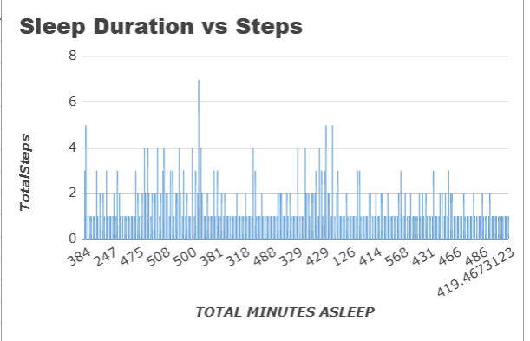
Sleep Duration vs Steps
What the Chart Shows:
Step count fluctuates across different sleep durations
No strong linear trend — but moderate sleepers tend to be more active
max growth
Insight:
Users with moderate sleep (6–8 hrs) generally show higher activity. Those with shorter sleep may be less active — likely due to fatigue or poor recovery.

Slide 6
RECOMMENDATIONS
Targeted Ads
Gamification & Challenges
Collaborate
Market to fitness-conscious consumers emphasizing how the wearable app can help optimize sleep and exercise patterns for better performance
Introduce engaging in-app challenges that reward users for achieving balanced sleep and step goals Users could earn badges, points, or wellness streaks, encouraging long-term habit formation and a sense of accomplishment
Partner with sleep specialists, mindfulness apps, or sleep tech startups to promote holistic sleep-health behavior — positioning Bellabeat as a 360° wellness solution.

Slide 7
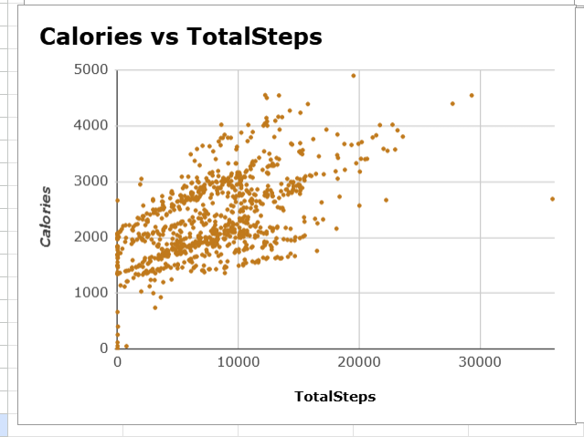
Calories Burned vs Steps
What the Chart Shows:
A positive correlation between steps and calories burned
A steeper increase in calories burned beyond certain step counts
Some variability — not all high-step users burn the same number of calories
Key Insights:
More steps = more calories burned, but intensity plays a key role
Walking pace, metabolism, and movement style affect individual outcomes
Short, high-intensity bursts may boost calorie burn more than extra steps alone

Slide 8
RECOMMENDATIONS
Subscription-Based Coaching
Nutrition Partnerships
Competitive Features
Offer premium features like AI-driven coaching that suggests the best movement patterns for optimized calorie burn
Partner with diet and nutrition brands to provide meal planning guidance tailored to users’ energy expenditure
Introduce leaderboards or challenges where users compete based on step count and calories burned

Slide 9
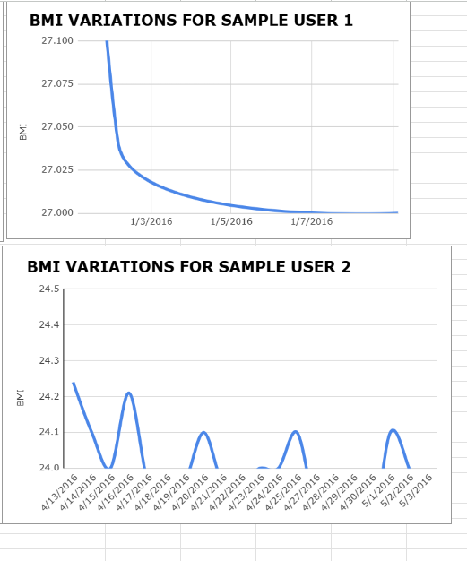
BMI Trends
Key Points from BMI Charts
User 1: Sharp BMI decline over a short period (Jan 3–7, 2016) — indicates rapid change.
User 2: Frequent BMI fluctuations over a longer period (Apr 13–May 3, 2016) — shows variability in habits.
Insights
Engagement Patterns: Some users show rapid progress; others exhibit fluctuating trends.
Personalized Approach Needed: Tailor recommendations—motivate consistency or improve progress tracking.
Timeframe Matters: Quick changes suit short-term feedback; fluctuations require long-term analysis.

Slide 10
RECOMMENDATIONS
Personalization
Progress Visualization Tools
Targeted Messaging
Market different wellness plans based on engagement types—users seeing rapid results may appreciate achievement-based rewards, while fluctuating users might prefer long-term coaching or stability-focused plans.
Promote data-driven feedback in your app—clear visual trends help users understand progress, encouraging engagement.
Fitness enthusiasts vs. casual health trackers need different messaging—motivational content for rapid changers and educational content for fluctuating users.

Slide 11
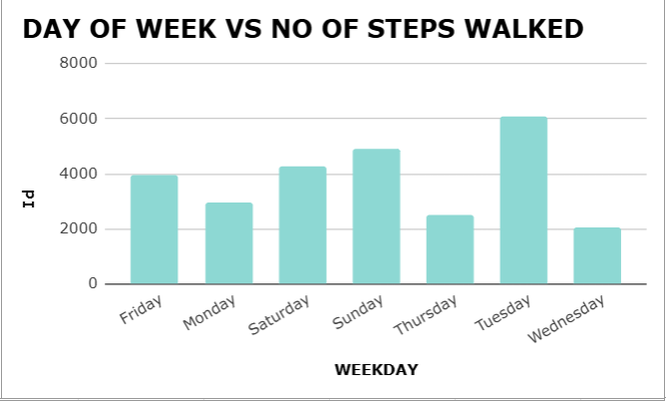
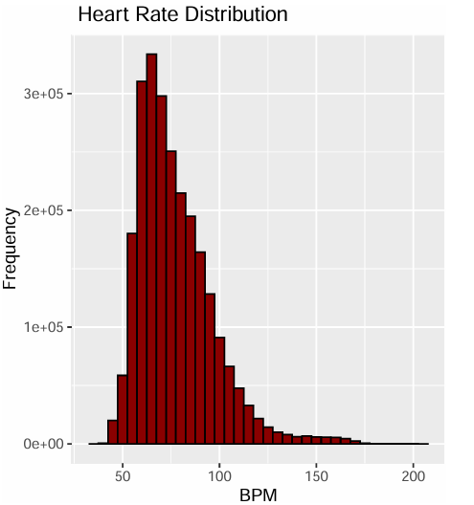
Other Noteworthy Insights
Most users stay in 60–90 BPM — resting zones; potential to target cardio training
Users walk most on Tue/Wed — ideal days for in-app challenges

Slide 12
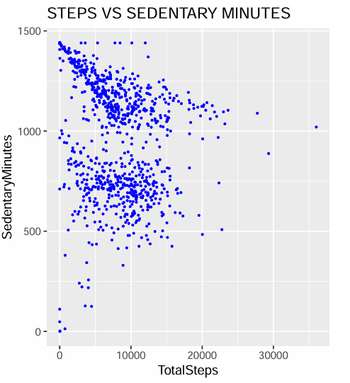
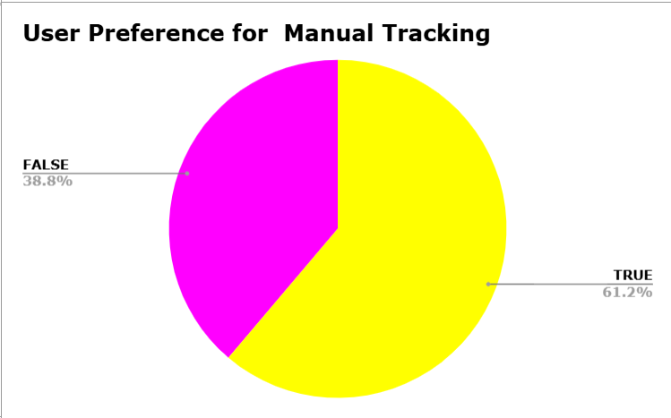
Other Noteworthy Insights
Many users log manually — Bellabeat can reward consistency
Bellabeat can support low-activity users with baseline step tracking and gradual movement goals to build healthier routines.

Slide 13
Impact & Business Value
Based on the data-driven visual insights, we recommend.
🎯 User Insight | 💡 Recommendation | 📈 Business Value
Many users are highly sedentary | Introduce gentle step nudges and daily movement streaks | Improves engagement among low-activity users
Most users have moderate sleep, but patterns vary | Provide personalized sleep–activity balance tips | Increases app usefulness and trust
Heart rates fall within resting zones | Recommend cardio-focused training suggestions | Helps users level up fitness using in-app plans
Manual weight logging is common | Offer reward badges for consistent loggers | Builds user loyalty and routine behavior
Engagement drops on weekends | Push weekend mini-challenges and social leaderboards | Sustains weekly activity streaks
High METs are rare in some users | Educate users on energy zones and suggest more active goals | Drives goal-setting behavior

Slide 14
Personal Reflection or Learning
Learned to clean and analyze multi-granular data (daily, hourly, per second)
Applied R, spreadsheets, and visual storytelling
Developed strategic thinking by translating data into marketing insights
Improved documentation and reporting for real-world audiences
“This project helped me connect raw data to real human behavior — and tell a story that supports smarter decisions.”

Slide 15
Resources & Full Analysis
📁 Data Cleaning & Preparation
The complete data cleaning process — including dataset selection, duplicate handling, formatting, and preprocessing steps — is fully documented.
🔗 View the documentation: Bellabeat Data Cleaning and Preparation.doc
Detailed Analysis & Visual Report
All charts, statistical insights, and visual interpretations were created using R and compiled into a clean, interactive HTML report.
🔗 View the full report: Click here to view the Bellabeat Analysis HTML Report
Also available as document :Bellabeat Analysis

Slide 16
CONCLUSION
This project allowed me to apply real-world data analytics skills — from data cleaning and visualization to interpreting user behavior and recommending improvements.
Working with multi-level time series data taught me the importance of precision, personalization, and storytelling in wellness tech.
Bellabeat’s data tells a powerful story — and with the right features, the app can guide users not just to track their health, but to transform it.

